Slide 1
Confusing Hello World in JS AKA the 9 Deadly Dwarves

Slide 2
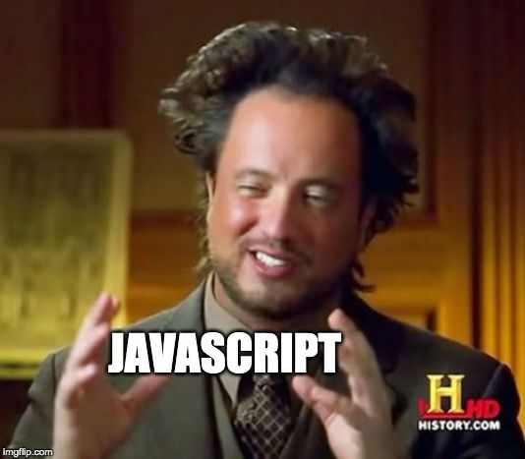

Slide 3
Data Types
As of the latest ECMAScript specification there are 9 types:
7 primitive data type and 2 structural types.
 | Primitive Data Type | Structural Type
1 | undefined | Object
2 | Boolean | Function
3 | Number
4 | BigInt
5 | String
6 | Symbol
7 | Null

Slide 4
Data Types
SNOBS ‘N’ BUF
trings
umbers
bjects
igInt
ymbol
ull
oolean
ndefined
unctions

Slide 5
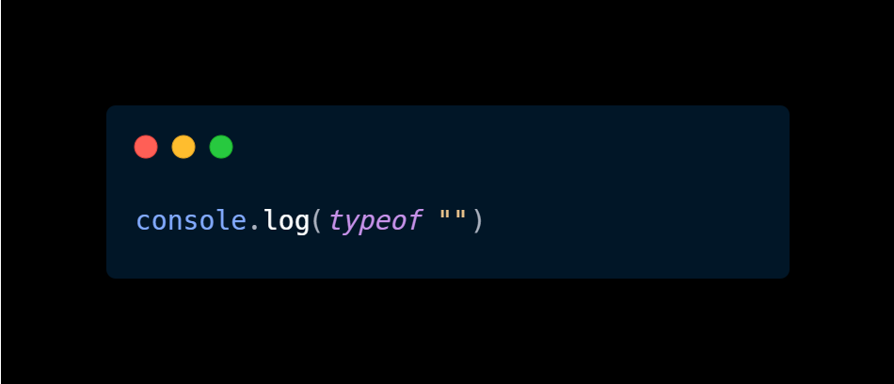
String
Examples:

Slide 6
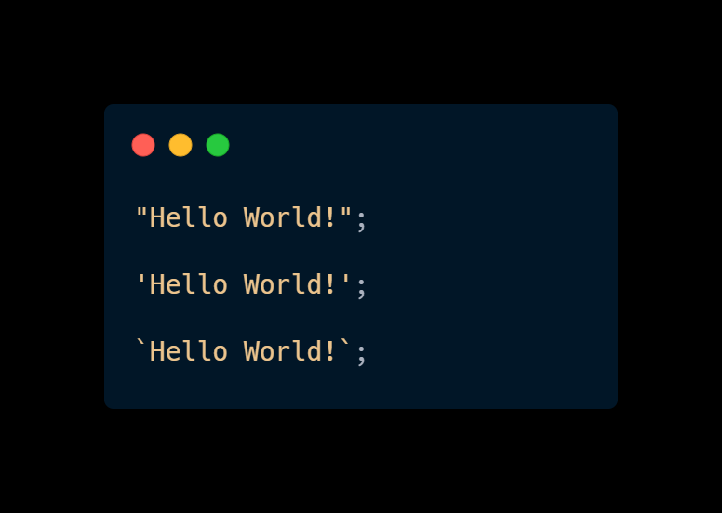
String
Examples:

Slide 7
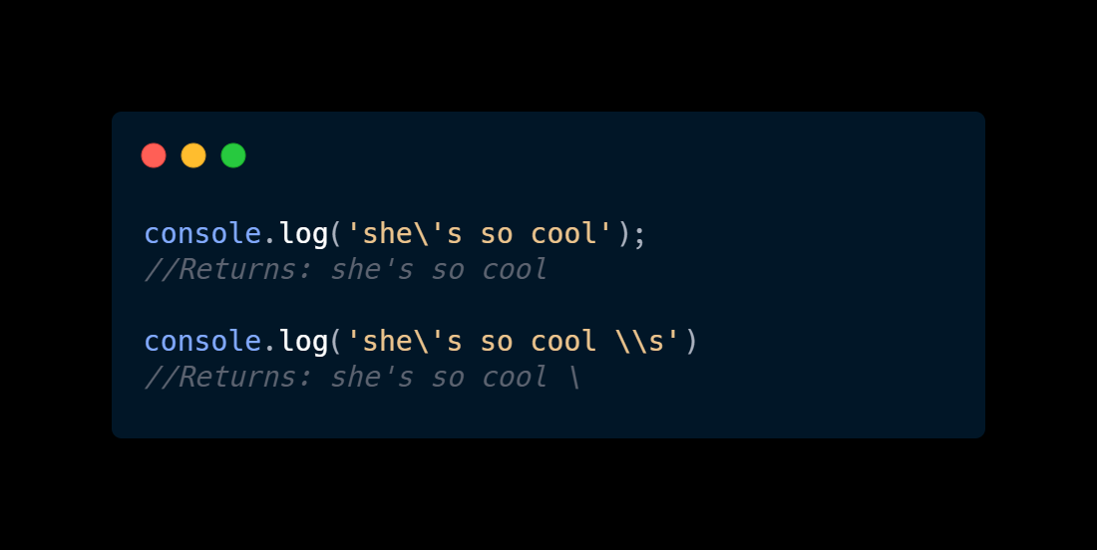
String
Examples:

Slide 8
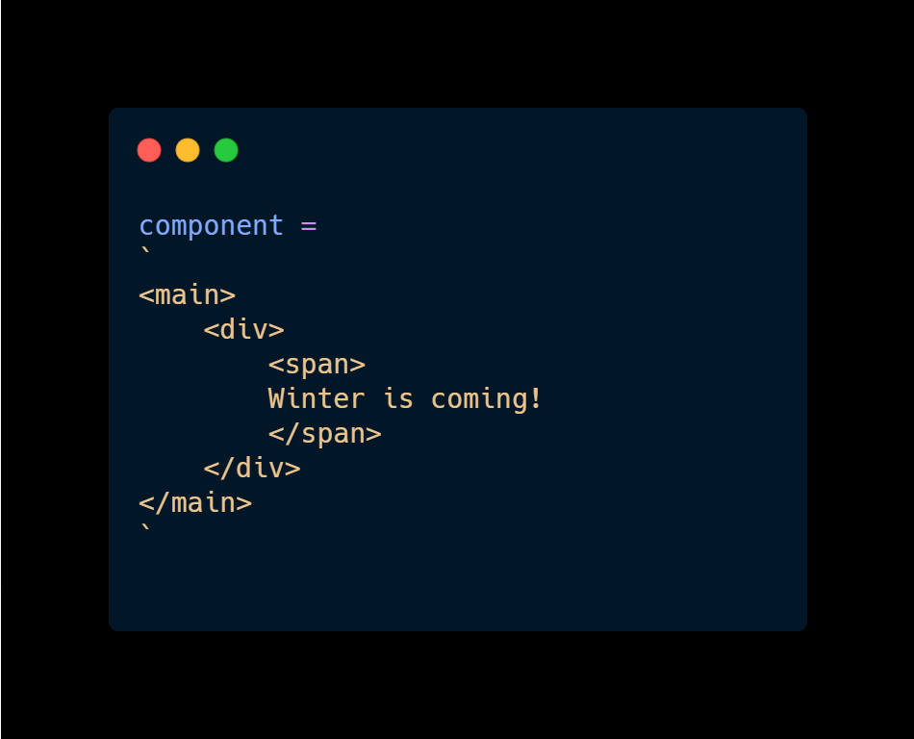
String
Examples:

Slide 9
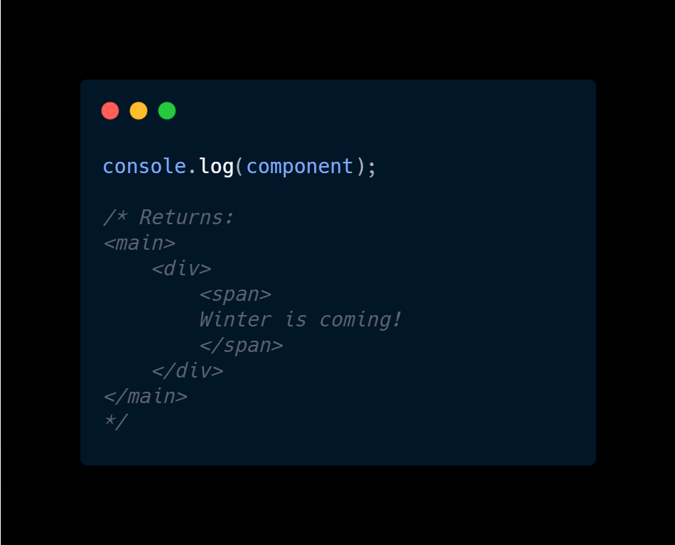
String
Examples:

Slide 10
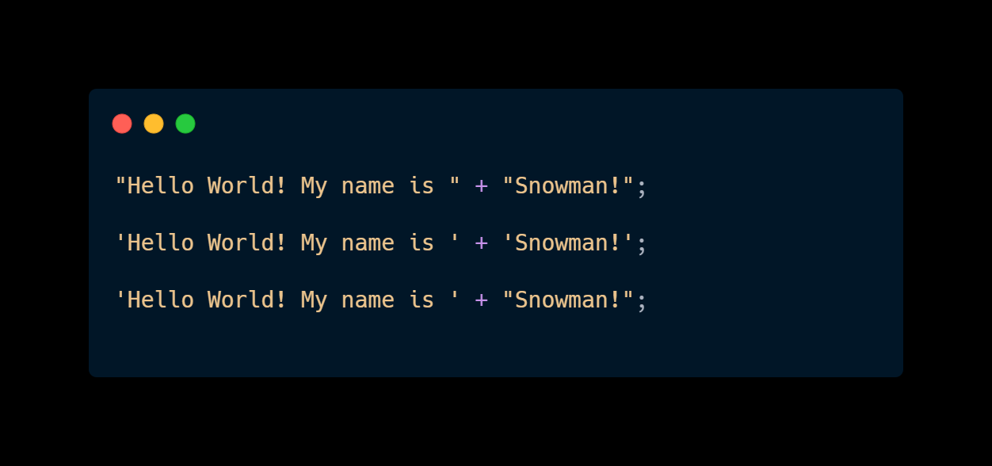
String
Examples:

Slide 11
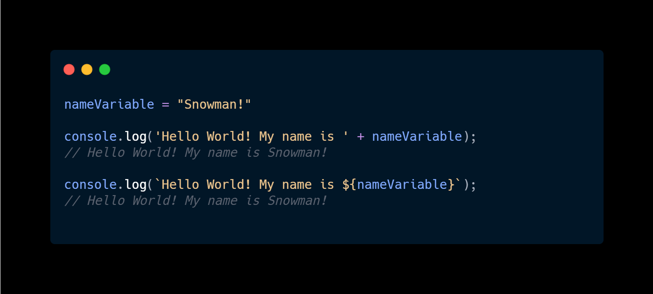
String
Examples:

Slide 12
String
Explanation:
Is a sequence of characters used to represent text.
Key Points:
Using back ticks instead of single or double quotes is faster for concatenation and interpolation.

Slide 13
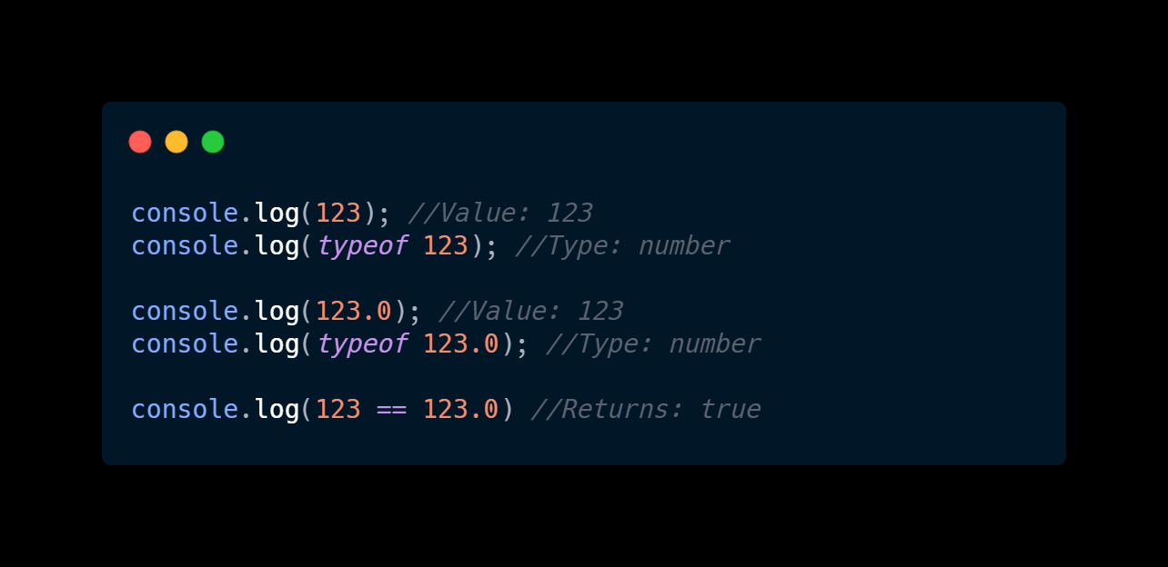
Number
Examples:

Slide 14
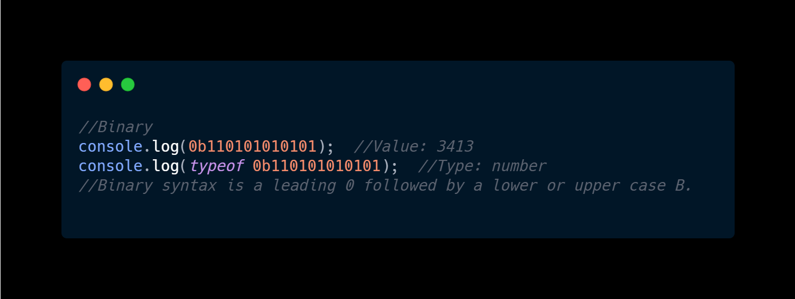
Number
Examples:

Slide 15
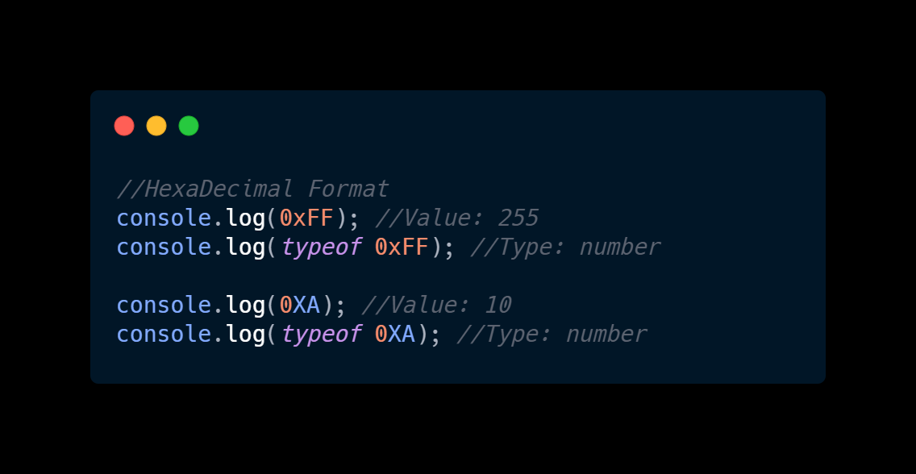
Number
Examples:

Slide 16
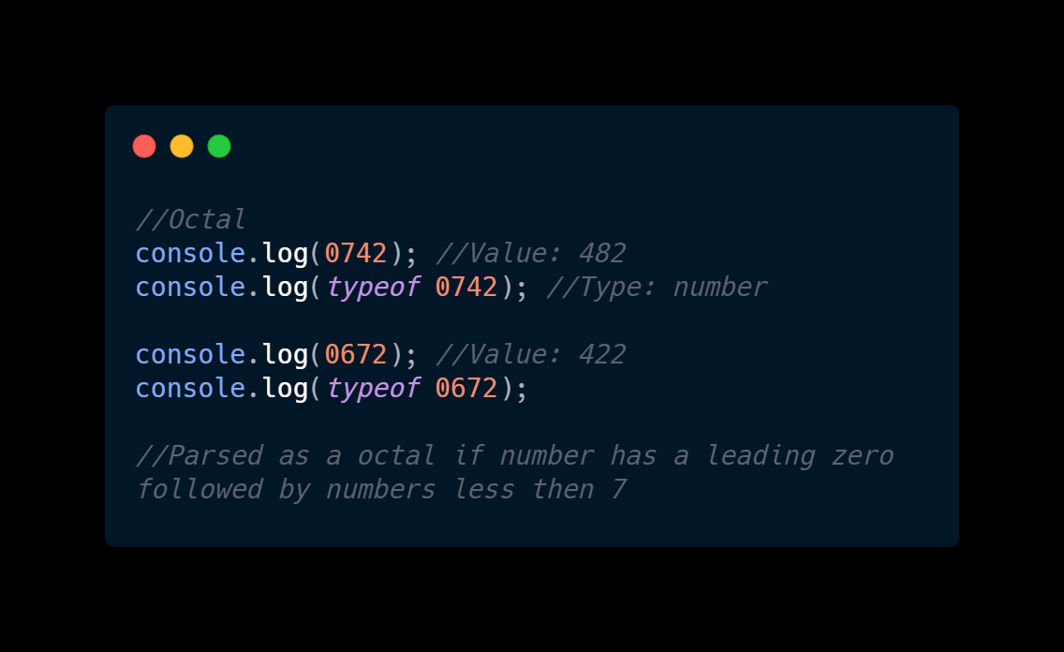
Number
Examples:

Slide 17
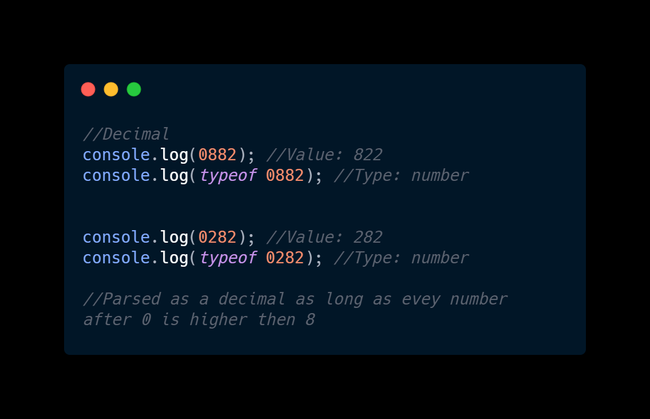
Number
Examples:

Slide 18
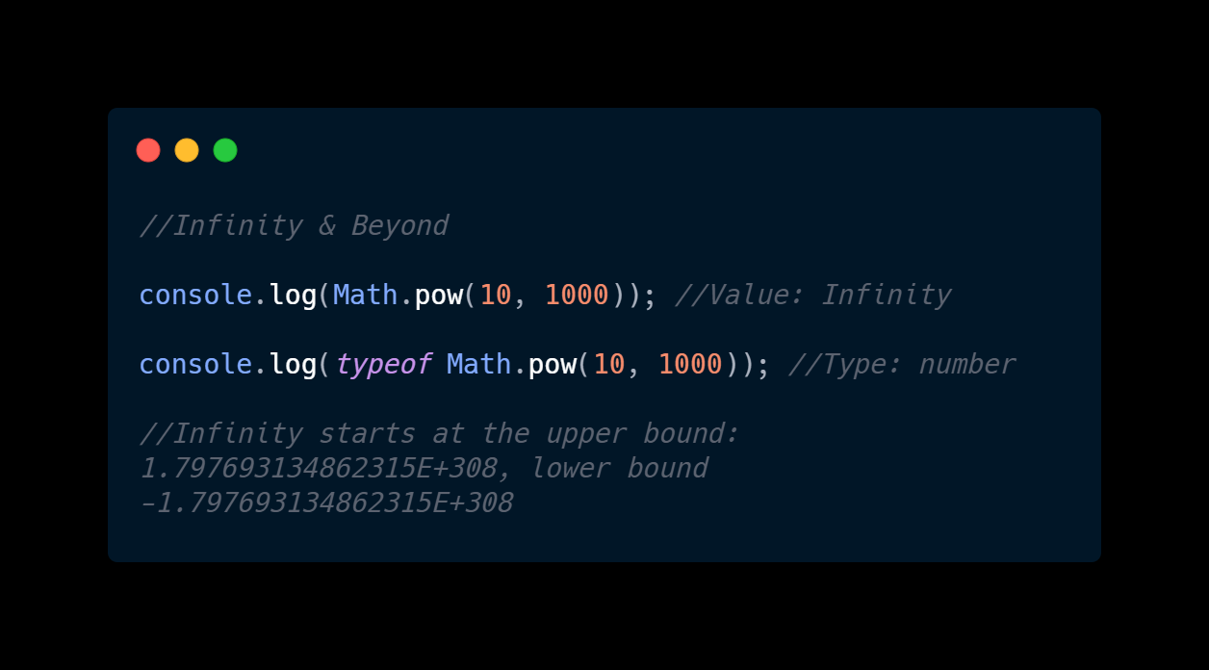
Number
Examples:

Slide 19
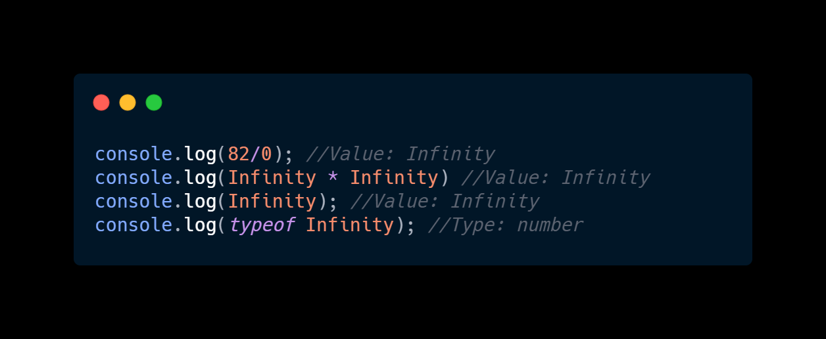
Number
Examples:

Slide 20
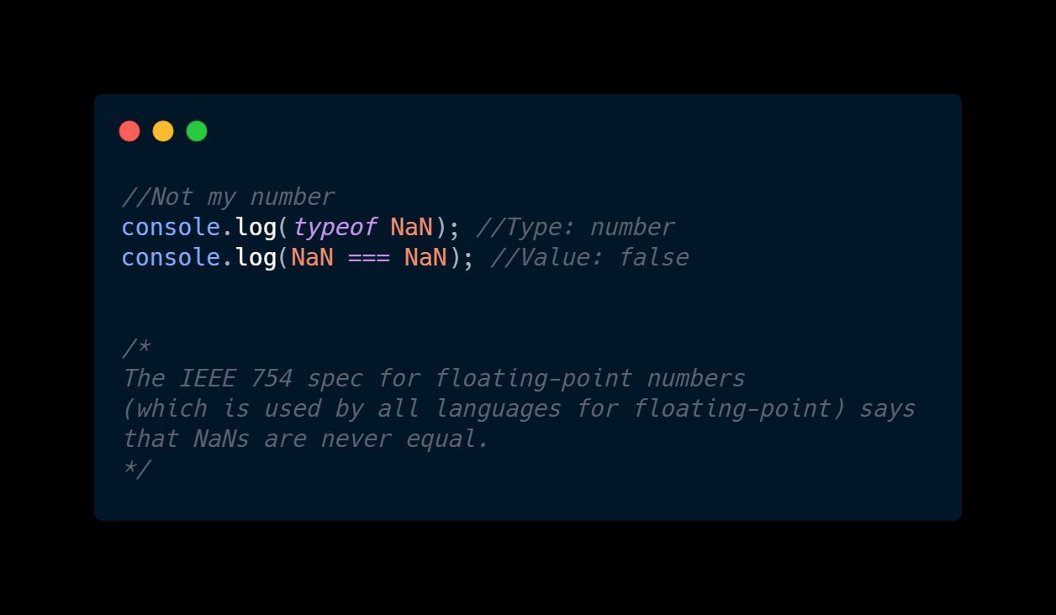
Number
Examples:

Slide 21
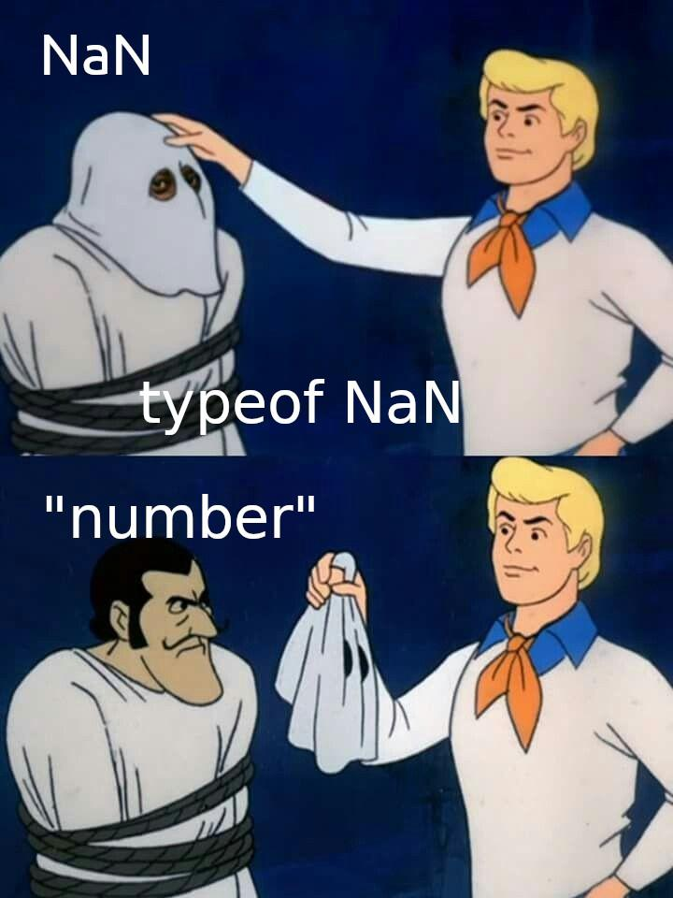
Number
Examples:

Slide 22
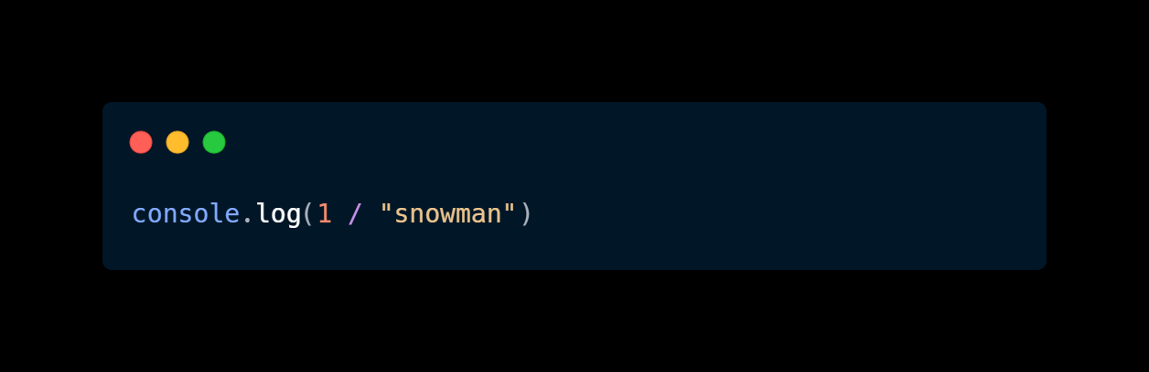
Number
Examples:

Slide 23
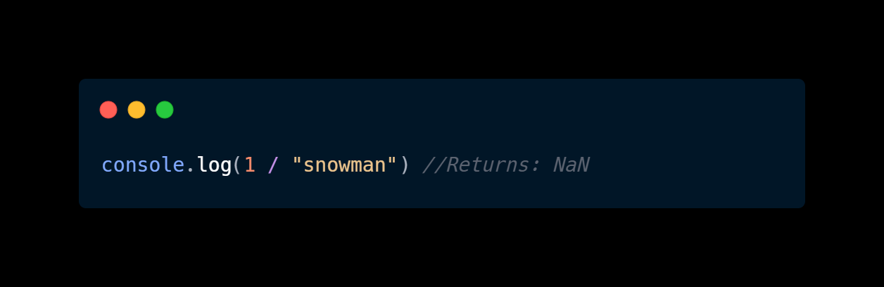
Number
Examples:

Slide 24
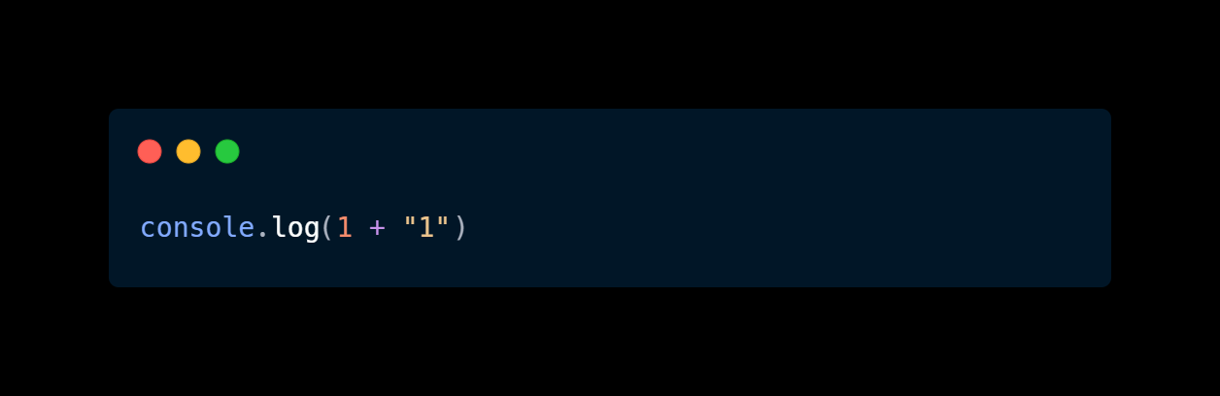
Number
Examples:

Slide 25
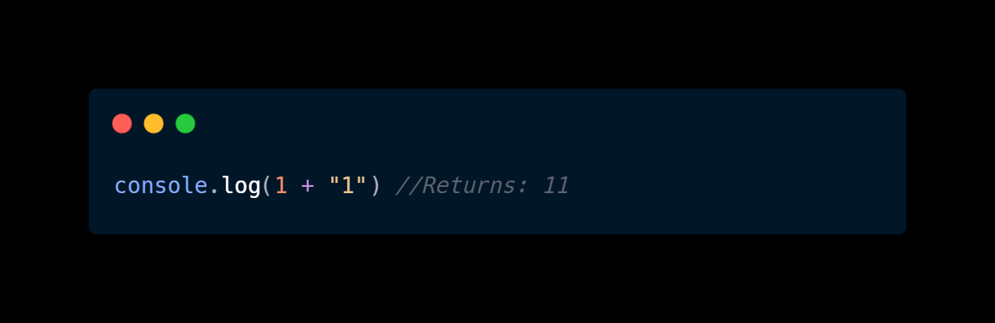
Number
Examples:

Slide 26
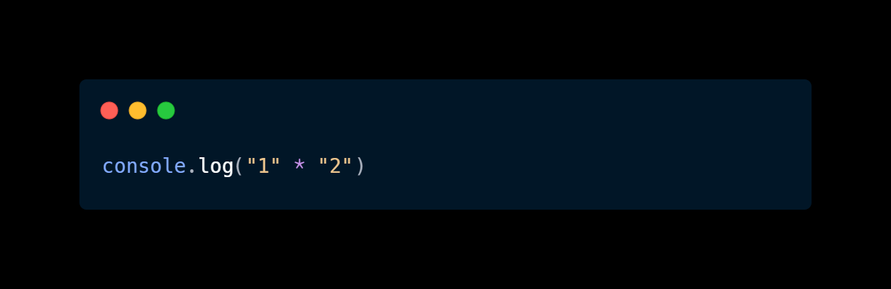
Number
Examples:

Slide 27

Number
Examples:

Slide 28
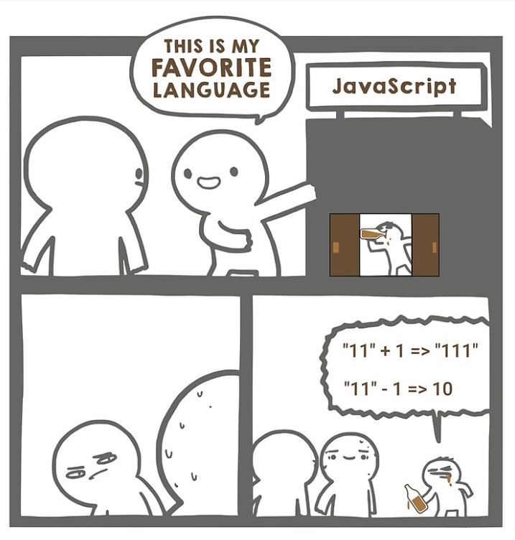

Slide 29
Number
Explanation:
Number is a primitive data type that is a double-precision 64-bit binary format IEEE 754 value, like double in Java or C#. Any value that is a number is a floating point value and not a integer.
Key Points:
Global properties such as NaN and Infinity are primitive number types .
Number conversion or operations drop the prefixing 0s.
Binary syntax is a leading 0 followed by a lower or upper case b.
Parsed as a octal if number has a leading zero followed by numbers less then 7
Parsed as a decimal if number has a leading zero followed by any number that is 8 or higher.

Slide 30
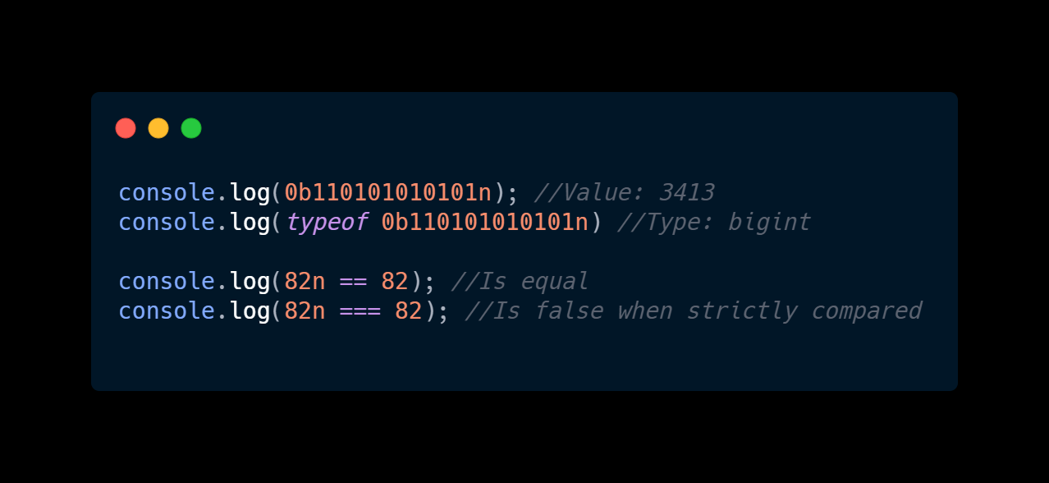
BigInt
Examples:

Slide 31
BigInt
Explanation:
You only need BigInts if you plan to exceed JavaScript’s largest “safe” integer (MAX_SAFE_INTEGER), the value being 9,007,199,254,740,991 (or 2⁵³-1).
Key Points:
BigInt is a primitive data type that is a perfect fit for the financial sector for mathematical operations utilizing large scales of numbers, which was previously filled by using libraries to fill that gap such as bn.js and yaffle.
On the other hand any operations done with BigInt are not in constant time, O(1), meaning they would be ill suited for cryptography.
A BigInt is created by appending n to the end of an integer literal — 10n — or by calling the function BigInt().

Slide 32
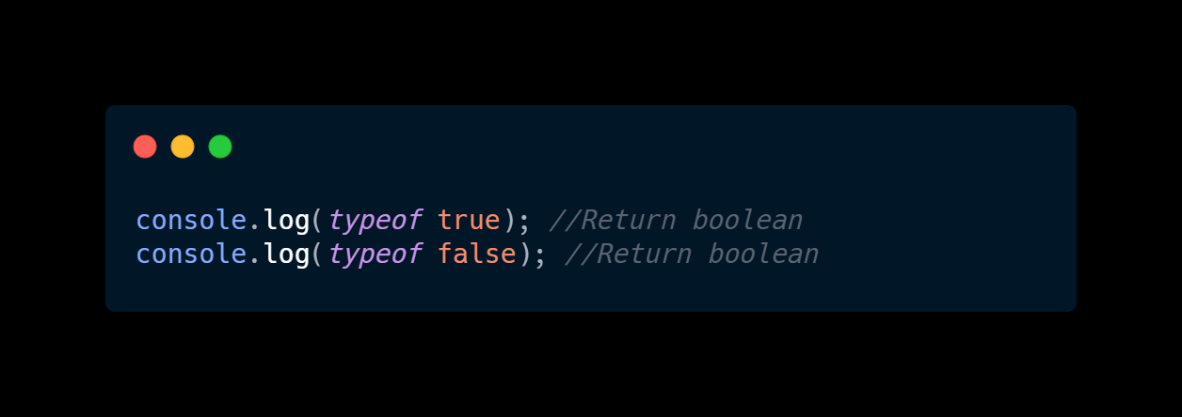
Boolean
Examples:

Slide 33
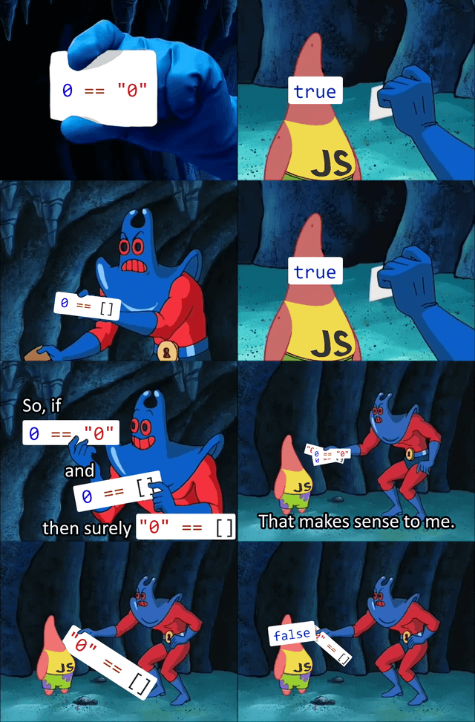
Boolean
Examples:

Slide 34
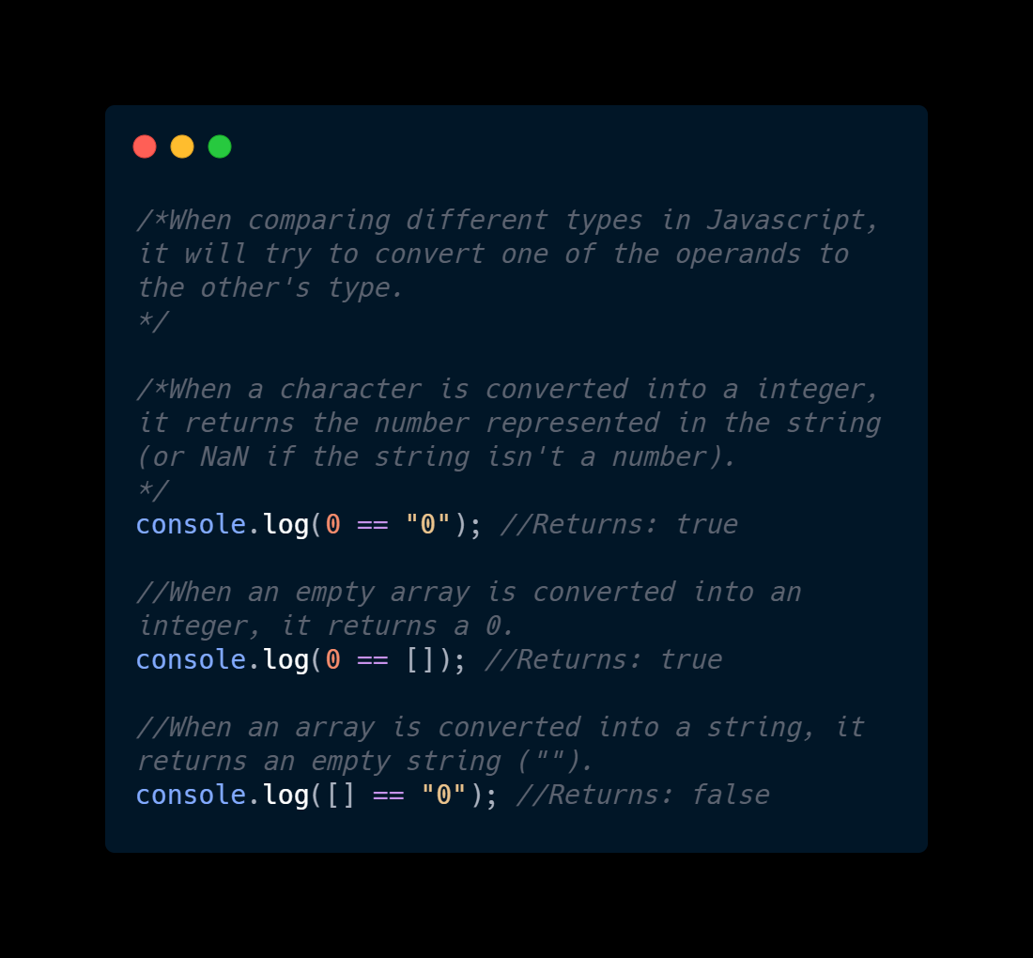
Boolean
Examples:

Slide 35
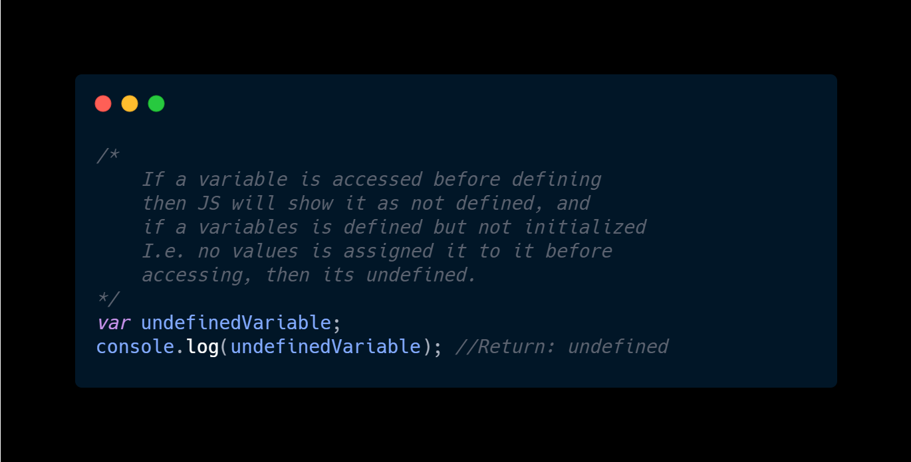
undefined
Examples:

Slide 36
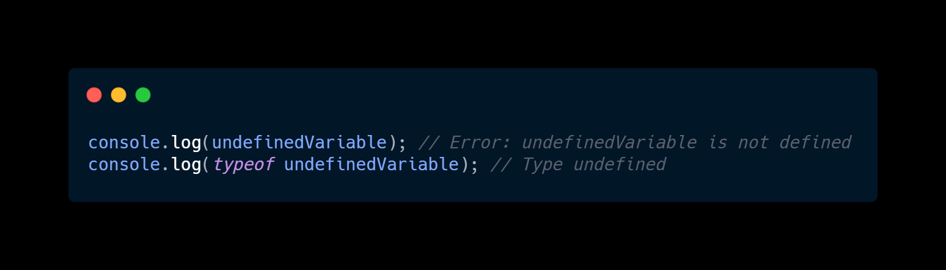
undefined
Examples:

Slide 37
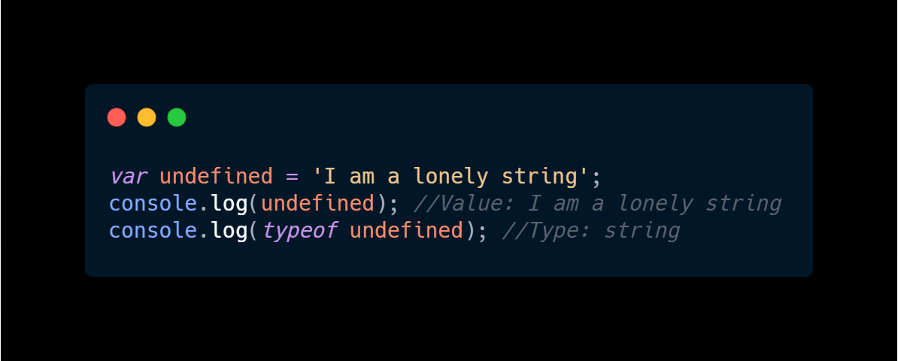
undefined
Examples:

Slide 38
undefined
Explanation:
undefined is a primitive value automatically assigned to variables that have just been declared, or to formal arguments for which there are no actual arguments.
Key Points:
Even though undefined is assigned to variables that does not have a value it is also possible to use it as an identifier, which convention is strongly apposed.

Slide 39
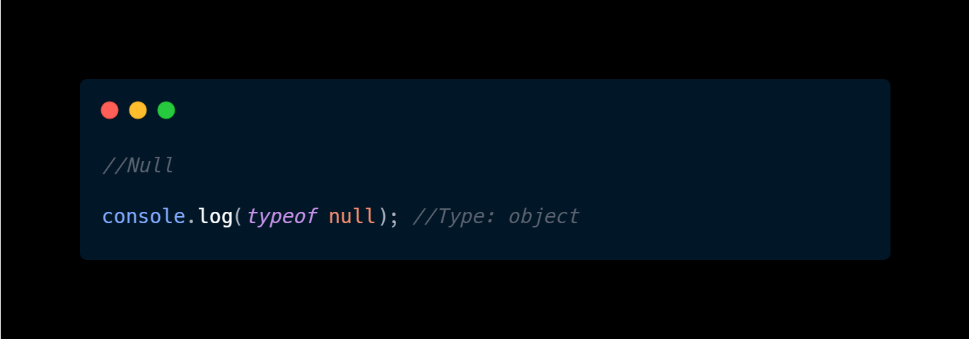
null
Examples:

Slide 40
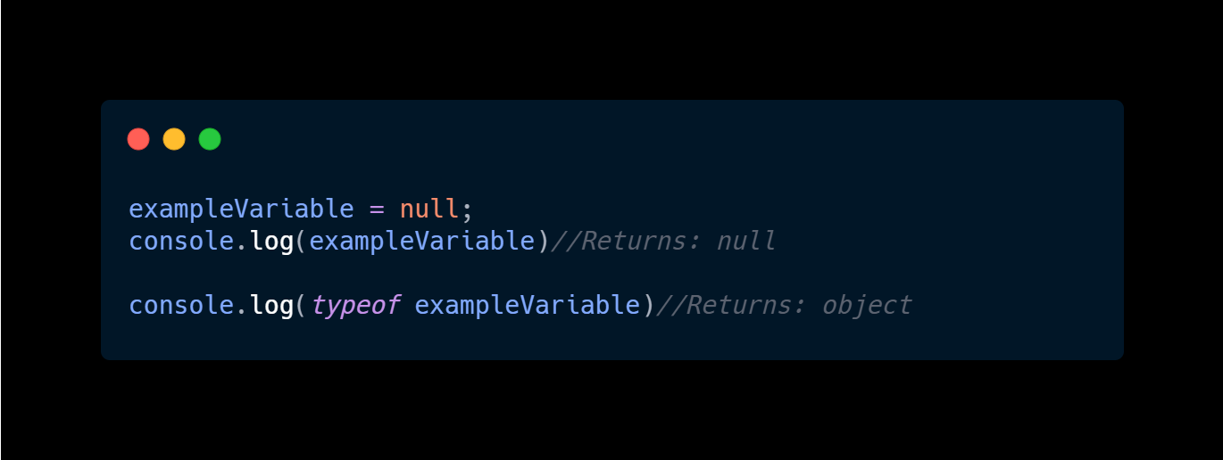
null
Examples:

Slide 41
null
Explanation:
Quote from the book Professional JS For Web Developers (Wrox):
"You may wonder why the typeof operator returns 'object' for a value that is null.
This was actually an error in the original JavaScript implementation that was
then copied in ECMAScript. Today, it is rationalized that null is considered a
placeholder for an object, even though, technically, it is a primitive value."

Slide 42
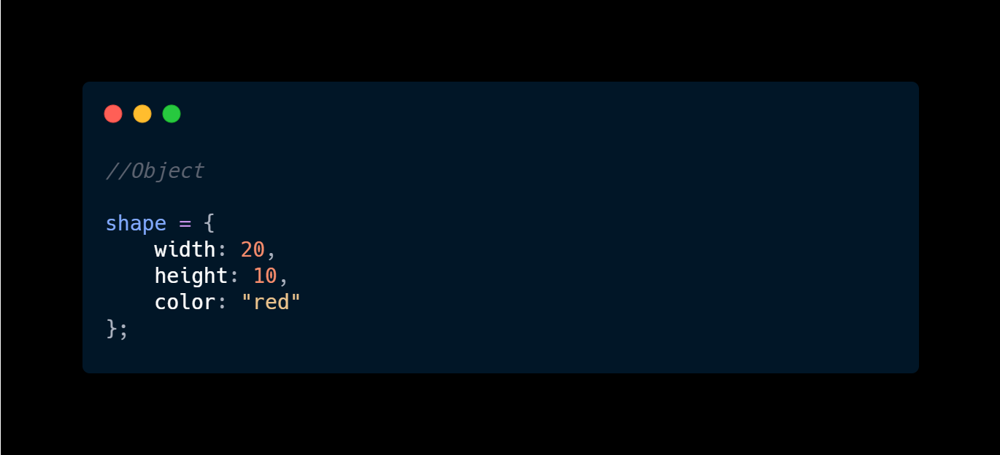
Objects
Examples:

Slide 43
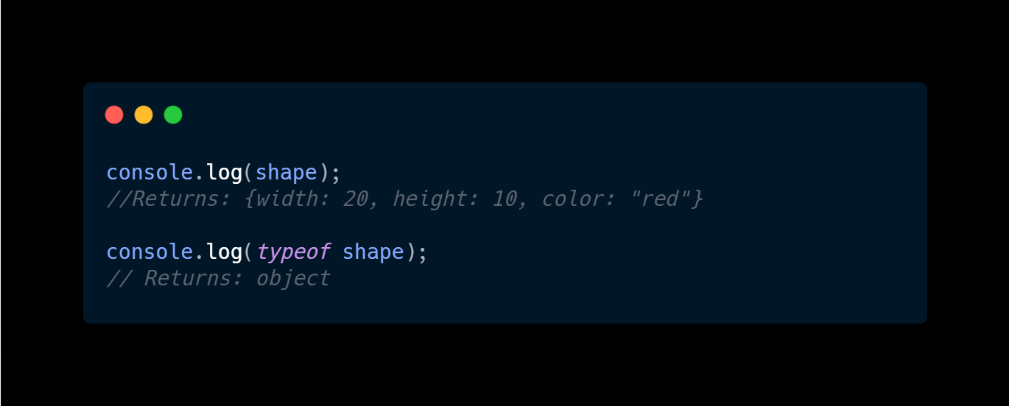
Objects
Examples:

Slide 44
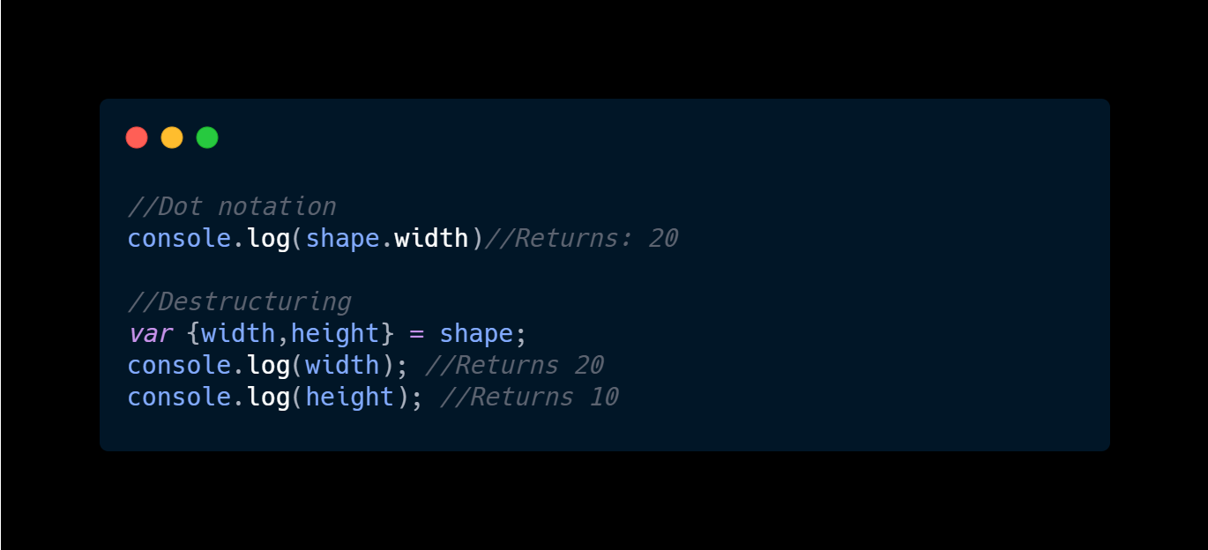
Objects
Examples:

Slide 45
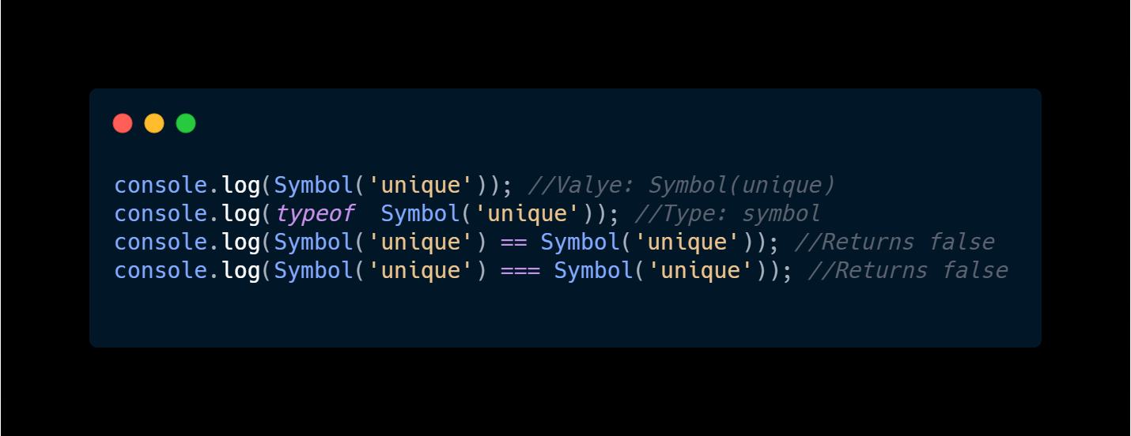
Symbol
Examples:

Slide 46
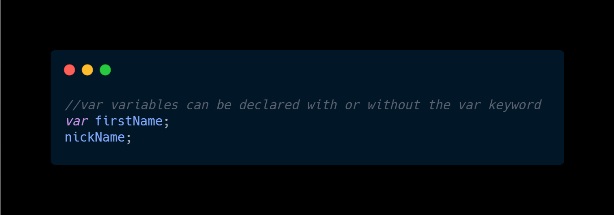
Variables
Examples:

Slide 47
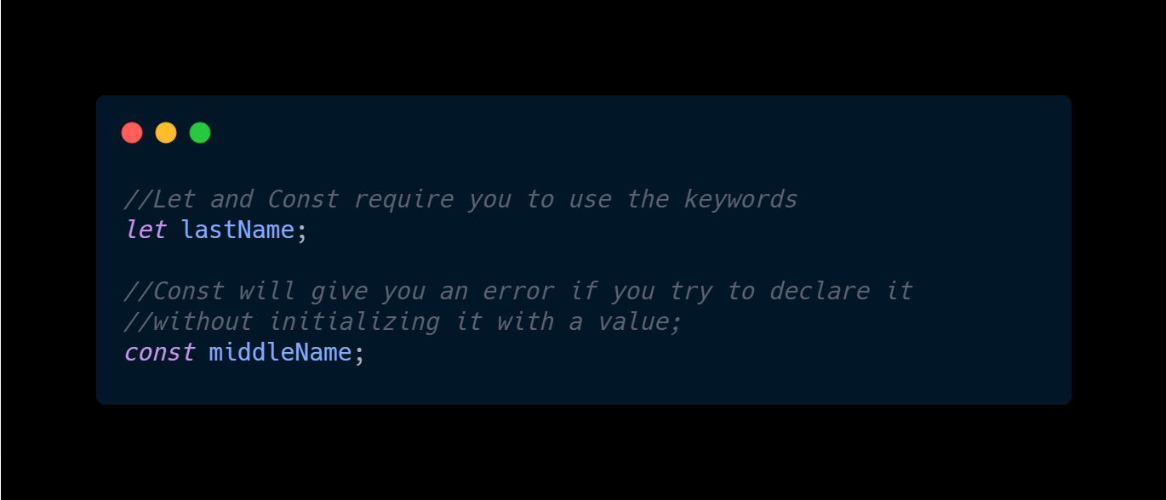
Variables
Examples:

Slide 48
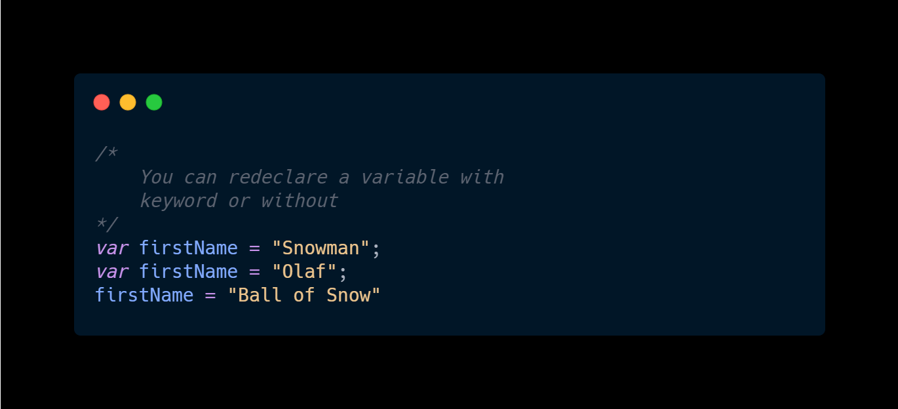
Variables
Examples:

Slide 49
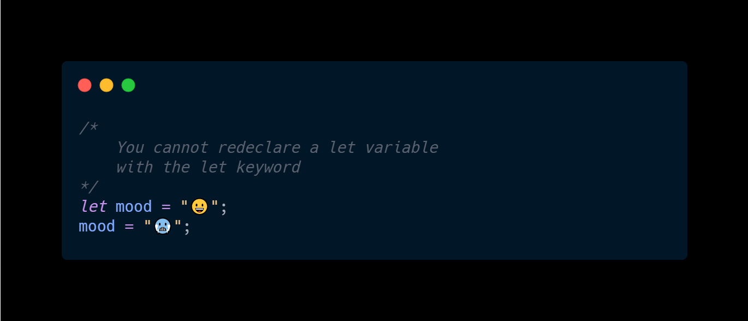
Variables
Examples:

Slide 50
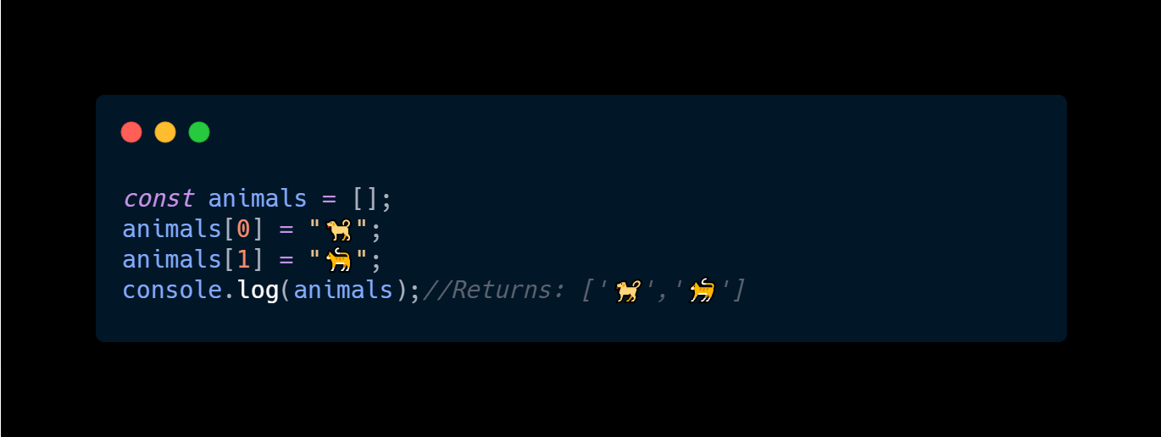
Variables
Examples:

Slide 51
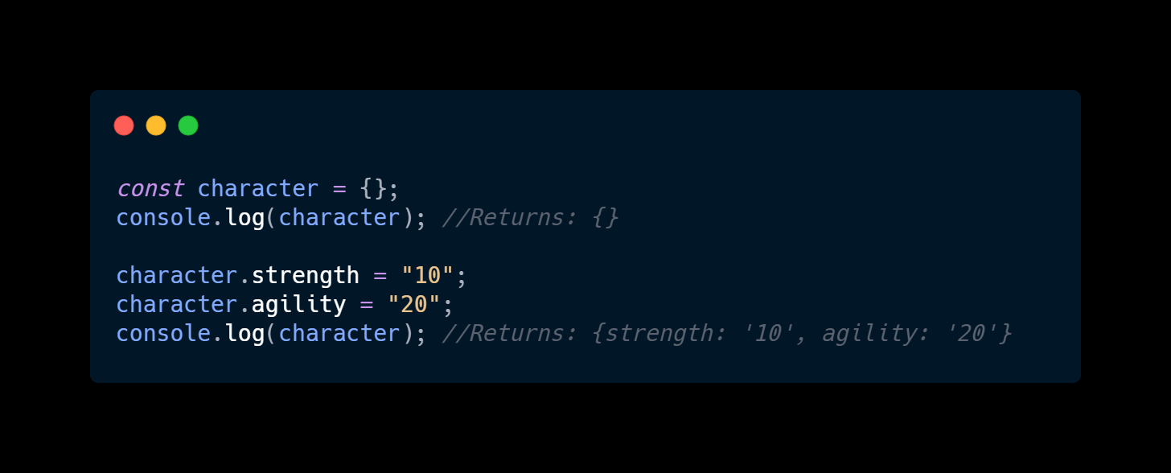
Variables
Examples:

Slide 52
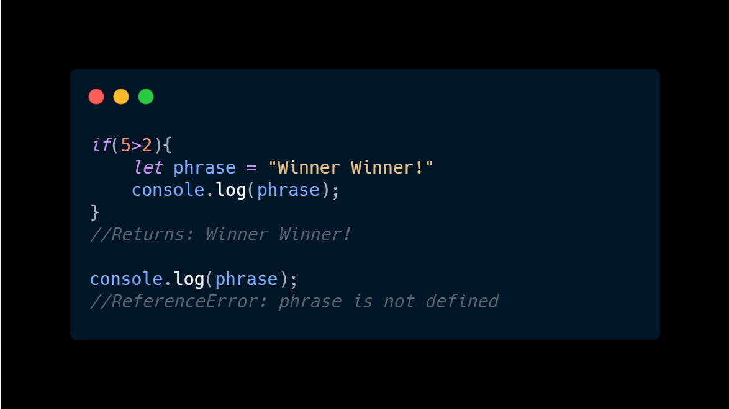
Variables
Examples:

Slide 53
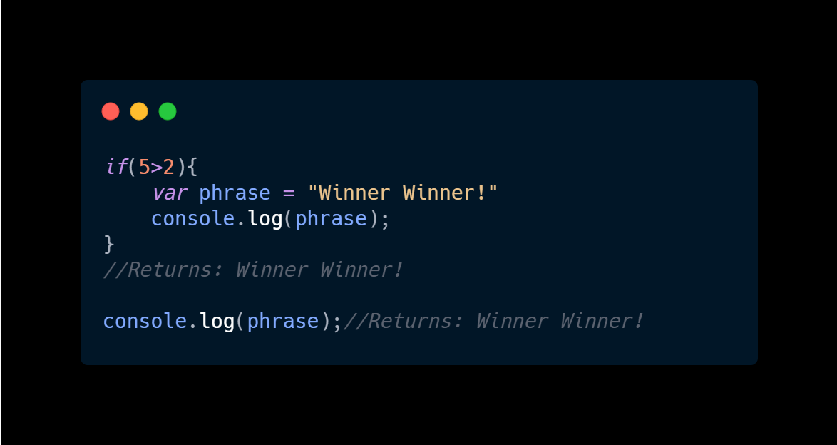
Variables
Examples:

Slide 54
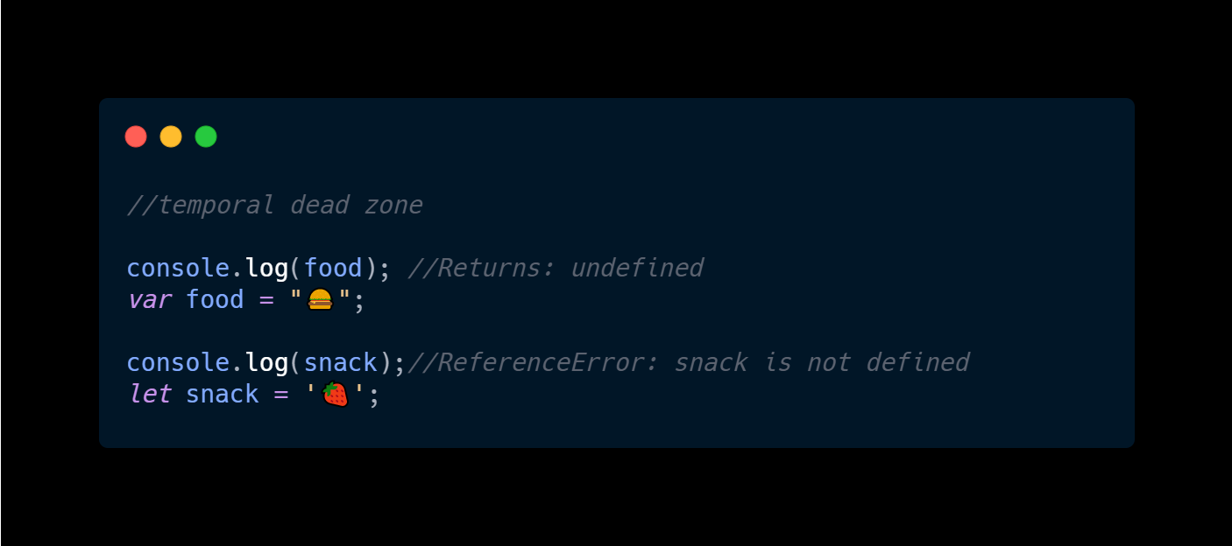
Variables
Examples:

Slide 55
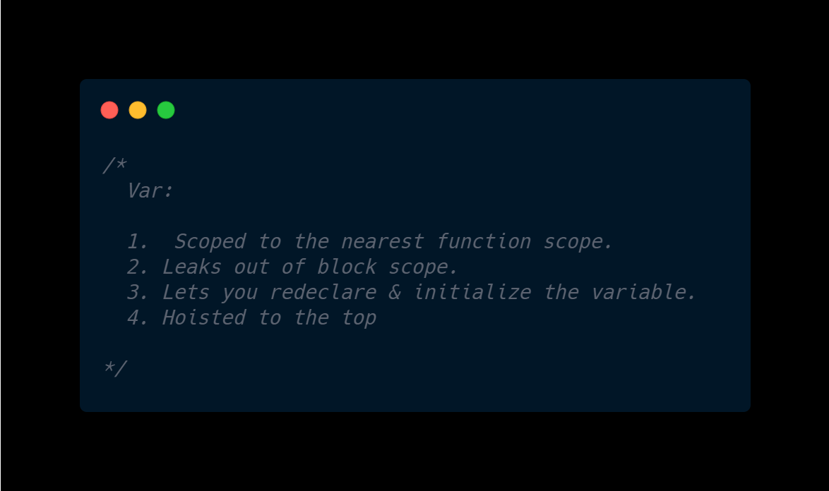
Variables
Examples:

Slide 56
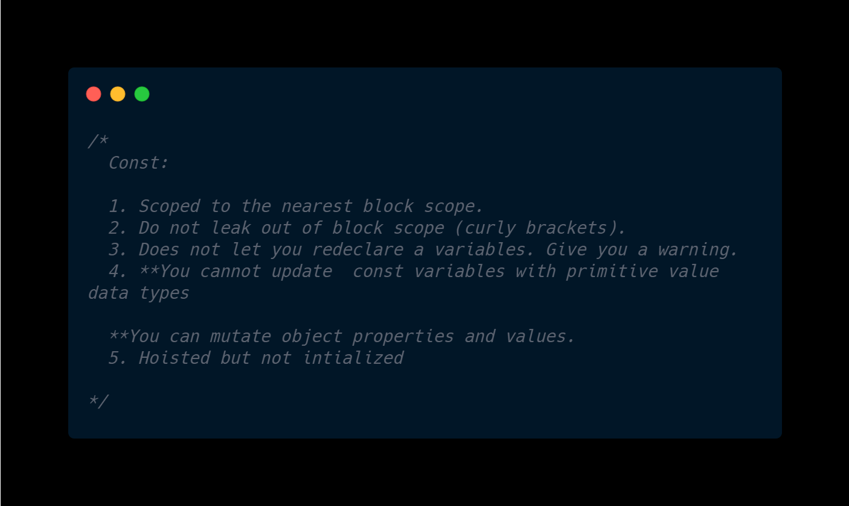
Variables
Examples:

Slide 57
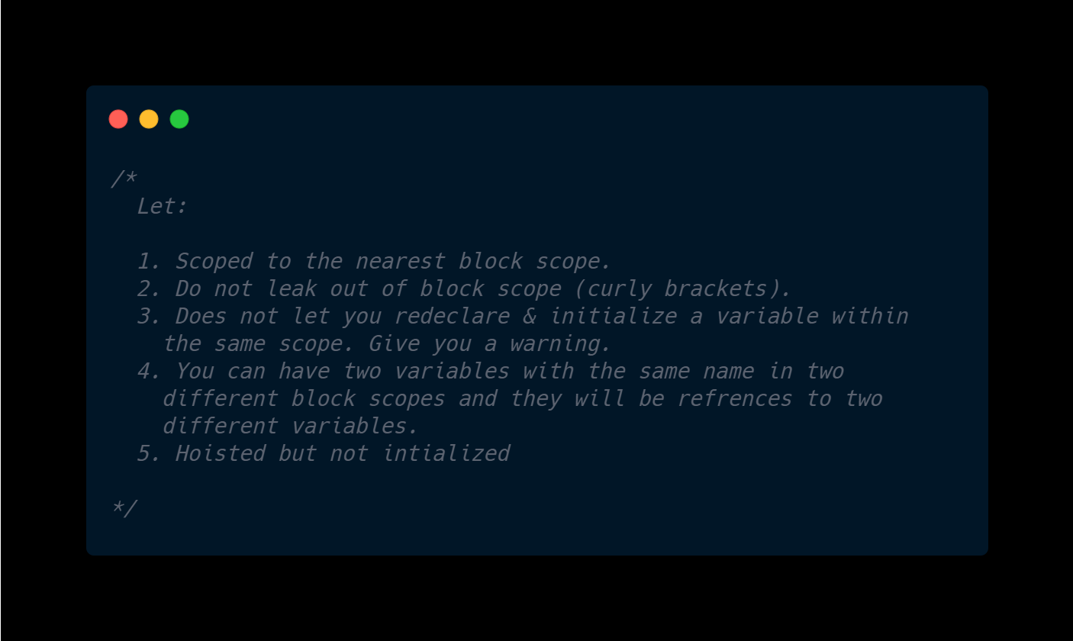
Variables
Examples:

Slide 58
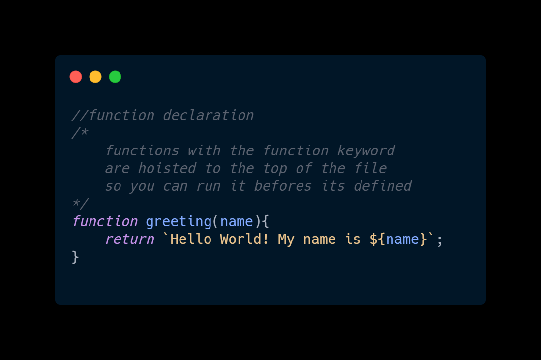
Function
Examples:

Slide 59
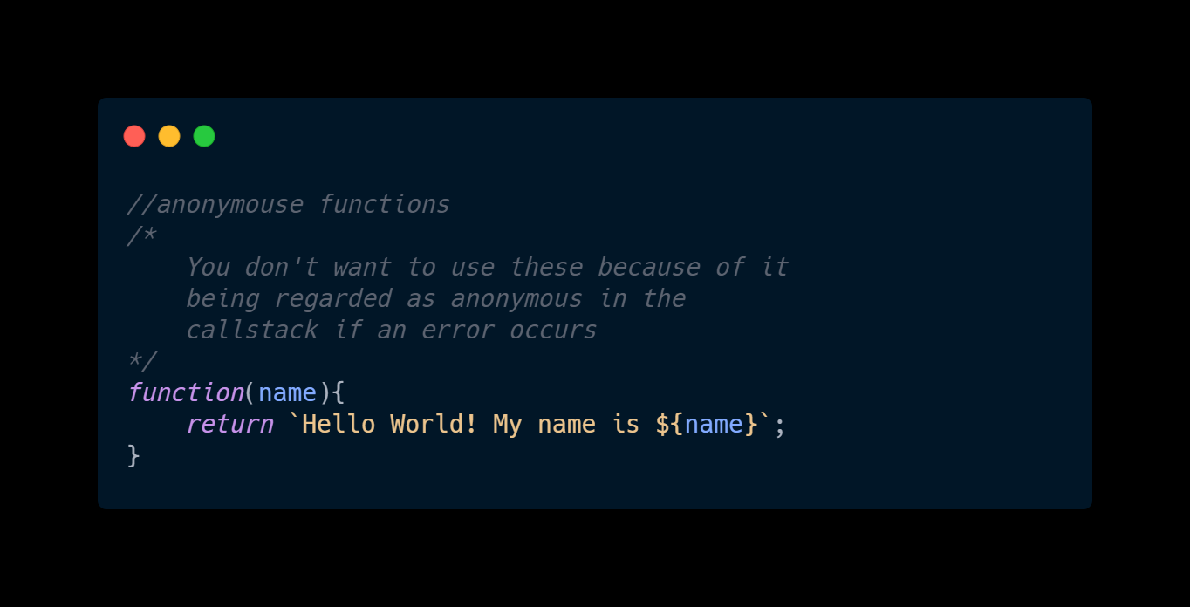
Function
Examples:

Slide 60

Function
Examples:

Slide 61

Function
Examples:

Slide 62

Function
Examples:

Slide 63

Function
Examples:

Slide 64

Function
Examples:

Slide 65

Function
Examples:

Slide 66

Classes
Examples:

Slide 67

Classes
Examples:

Slide 68

Classes
Examples:

